Slide 1
Agent Network Platform
Managing agent network on system

Slide 2
Workshop Agenda
Timings | Section | Activity
9.30 - 9.45 | Introductions | Review intro material and clarify any questions
9.45 - 9:55 | Agree onboarding flow | Walkthrough of flow and flag any change in order of steps
9:55 - 11:00 | Review each step in onboarding flow | Spend 5 minutes per step Agree status Agree users Notifications and triggers Clarify open questions
11:00 - 11:10 | Agree offboarding flow | Walkthrough of flow and flag any change in order of steps
11:10 - 11:45 | Review each step in offboarding flow | Spend 5 minutes per step Agree status Agree users Notifications and triggers Clarify open questions
11:45 - 11:50 | Close out | Agree next steps and any follow ups

Slide 3

Where are we now?
In 2020 we embarked on a project to move the management of KOKO’s agent network ‘on system’ and away from spreadsheets.
Managing the agent network involves 7 teams operating >35 processes. Some processes were well defined while others need redesigning.
The challenge is deciding what to build first to so that the system becomes the source of truth for agent network management.
Not all the processes need to be done on system right away but enough data needs to be there to stop people reverting to spreadsheets.
Therefore we have narrowed the focus to building an MVP (minimum viable product) for onboarding and offboarding (agents, shops and KPs).

Slide 4
MVP for managing Agent Network on system
The MVP (minimum viable product) for managing the agent network on system is constantly changing as we learn more about running the business.
Replicating existing fields in spreadsheet covers the goal of replacing spreadsheets but will quickly be out of sync if another process not on system changes that status.
Replicating all processes on system will take time and mean value of the UVA workstream won’t be achieved until late 2021.
The MVP is somewhere in the middle taking into account how agents, shops and KPs move through the lifecycle.
It’s important to note the MVP is not the end of development on the agent network platform ….
Time
Agent Network Processes
All agent related processes on system.
MVP
Replicating fields in spreadsheet

Slide 5
Agents, shops and KPs
An agent is the individual with who KOKO enters an agreement to provide KOKOpoints.
The shop is the location the agent provides for KOKOpoints. An agent can own many shops.
Customers visit shops to buy fuel from KOKOpoints. We are trialling multiple KPs in shops.
Each of these entities have their own lifecycle which is often dependent on an event / process of another entity. For example a shop is only active once a KP has been deployed and commissioned.
Agent
0..1
owns
1..n
Shop
1..n
houses
Entity | Lifecycle Phases
Agent | Prospect | Active | Inactive
Shop | Prospect | Active | Archive
KOKO Point | Warehouse | Deployed | Scrapped
0..n
KOKOpoints

Slide 6
Agent Process Outline
Agent | Prospect Agent Recruitment (AN) Agent KYC (Legal) | Active Payments (Finance) Termination (Agent Network) | Inactive
Shop | Prospect Shop Selection (AN) Shop KYC (Legal) Contracting (Legal) Payments (Finance) Inspection (Deployment) Civil Works (Deployment) Branding (Marketing) Shop readiness (Deployment) | Active Commissions (Finance) Agent Sales (AN) Termination (AN) Relocation (AN) Suspension (AN) Deliver Inventory (Cookers) | Archive Final dues (Finance) Retrieve Inventory (Deployment) Retrieve Branding (Deployment)
KOKO Point | Warehouse QC (Deployment) Repairs (Deployment) Deliver (Deployment) KP readiness (Deployment) Install (Deployment) Fuelling (Fuels) Calibration (Deployment) | Deployed Commission (NOC) Fuelling (Fuels) Maintenance (NOC) Calibration 2.0 (Deployment) Relocation (Deployment) Decommission (Deployment) | Scrapped Repair (Deployment) Break down (Deployment)
We brainstormed all the current processes that take place and mapped them to the relevant entity and lifecycle phase.
Individual processes have different owners and actors (see brackets) even though the overarching network is managed by the Agent Network Team.

Slide 7
Agent Process MVP
Agent | Prospect Agent Recruitment (AN) Agent KYC (Legal) | Active Payments (Finance) Termination (AN) | Inactive
Shop | Prospect Shop Selection (AN) Shop KYC (Legal) Contracting (Legal) Deposits (Finance) Inspection (Deployment) Civil Works (Deployment) Branding (Marketing) Shop readiness (Deployment) | Active Commissions (Finance) Agent Sales (AN) Termination (AN) Relocation (AN) Suspension (AN) Deliver Inventory (Cookers) | Archive Final dues (Finance) Retrieve Inventory (Deployment) Retrieve Branding (Deployment)
KOKO Point | Warehouse QC (Deployment) Repairs (Deployment) Deliver (Deployment) KP readiness (Deployment) Install (Deployment) Fuelling (Fuels) Calibration (Deployment) | Deployed Commission (NOC) Fuelling (Fuels) Maintenance (NOC) Calibration 2.0 (Deployment) Relocation (Deployment) Decommission (Deployment) | Scrapped Repair (Deployment) Break down (Deployment)
Then we outlined which processes must be online and should be online in order to stop managing the agent network on spreadsheets
Key:
Must be
Should be / Next
Offboarding and Onboarding are two key processes that involve multiple subprocesses so we went into a more detailed mapping process for these.

Slide 8
Workshop Objectives
In order to do detailed feature design to feed into software development, we need to clarify the following:
Validate processes: Are these the right stages for onboarding & decommissioning? Is anything in the wrong sequence? Is anything missing?
Team Roles: Which specific roles are involved with each stage? What does each role do (eg, in context of RACI)?
Statuses: What are the appropriate statuses for each stage? Have we captured them appropriately?
How will we update statuses? Automated (rules-based) vs. manual?
If automated, what are the rules?
If manual, who should have permission to change which statuses?
User Updates: How should we inform users about status changes? Who should be informed about which items?
Email? Tableau? Other?
Adjacencies: What other existing processes touch these steps (eg, fuel planning?)
Resolve open questions and feedback on terminology.

Slide 9
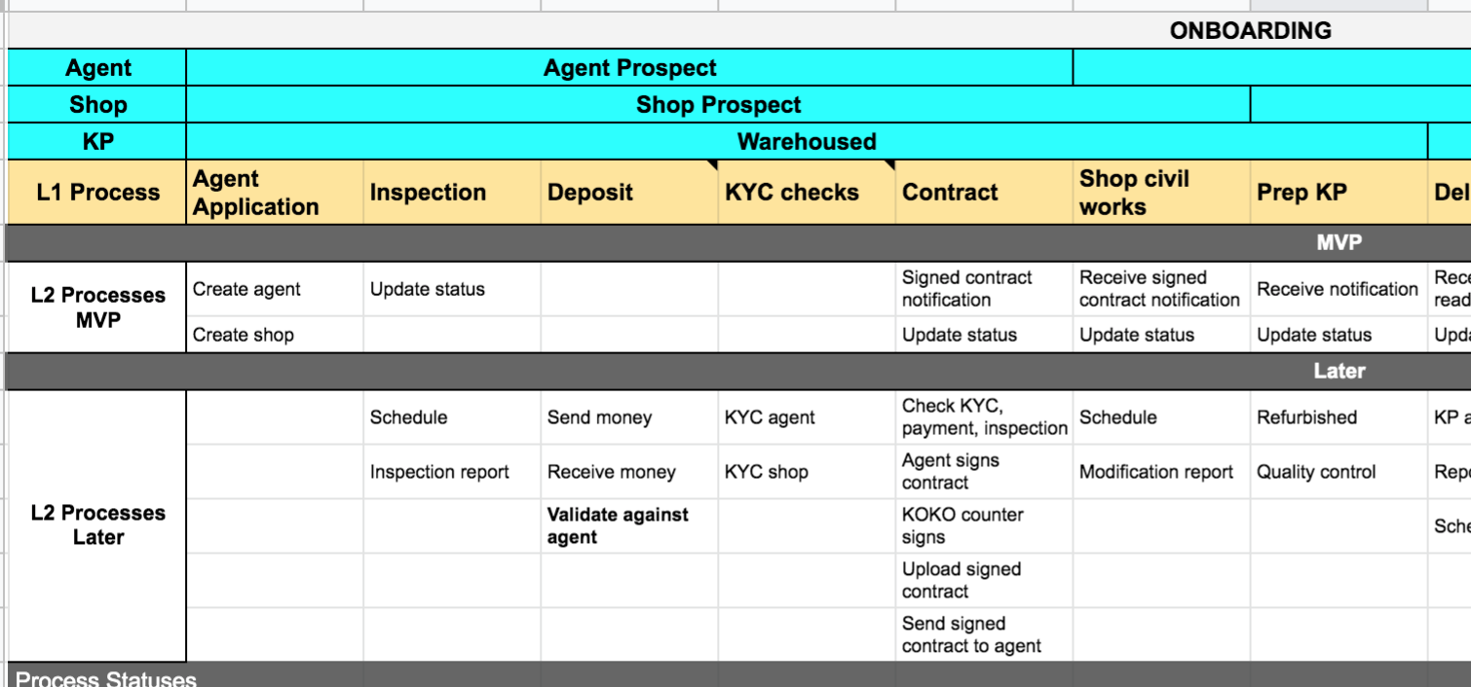
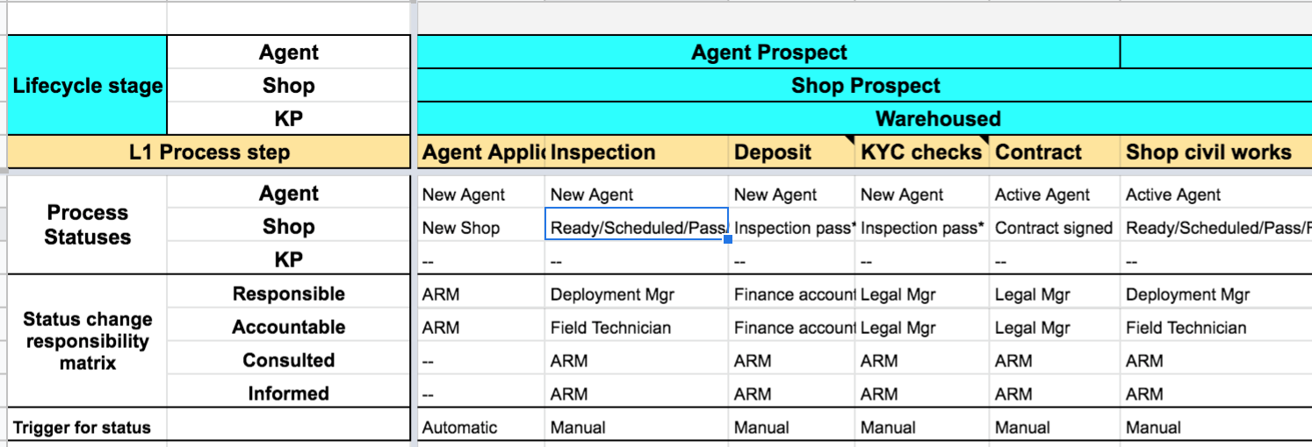
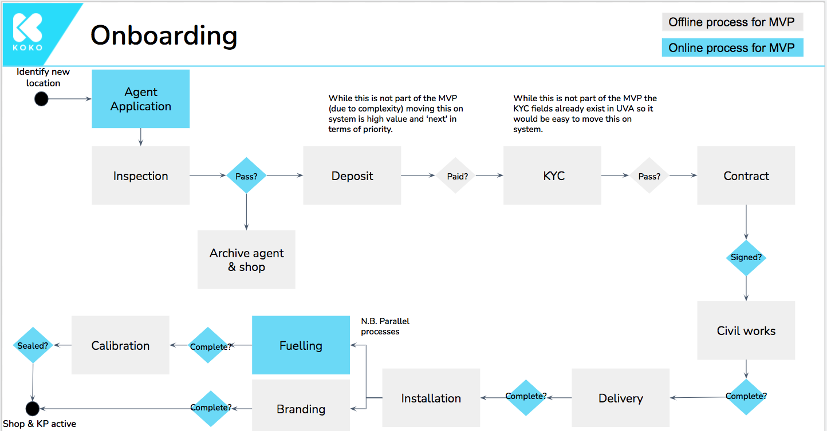
How to use the pre-read materials
We linked the various subprocesses for onboarding and offboarding.
Followed by separating out MVP vs later processes for onboarding and offboarding.
The next level of detail on the status and RACI tab includes:
Different statuses
Triggers for status change
Teams / Individuals involved
Open questions for resolution
On slides 11 and 12 we have included a high level overview of the to be process which can be used alongside the google sheet.
As onboarding is a more detailed flow we have created an extended version of the process flow here.
Notes:
The Ad aspect ratio should not appear on the ad itself.

Slide 10
Onboarding
Offline process for MVP
Online process for MVP
Identify new
location
Agent Application
While this is not part of the MVP (due to complexity) moving this on system is high value and ‘next’ in terms of priority.
While this is not part of the MVP the KYC fields already exist in UVA so it would be easy to move this on system.
Inspection
Deposit
KYC
Contract
Pass?
Paid?
Pass?
Archive agent & shop
Signed?
N.B. Parallel processes
Civil works
Calibration
Fuelling
Sealed?
Complete?
Installation
Delivery
Branding
Complete?
Complete?
Complete?
Shop & KP active
Notes:
Can we only fuel a KP that is active? How do the first ones get filled? If they are not linked on system?
Is cooker delivery a mandatory step? Only really happens once shop is active?
Need a requirement for arhiving a shop from propspect status.

Slide 11
Offboarding
Offline process for MVP
Online process for MVP
Agent wants to leave KOKO
Agent Network informs Legal of a termination
Legal issue formal notice
ARM/ARR send to agent to sign
Agent signs
Termination letter is filed
KOKO decides to terminate shop
Teams are informed
Update status
Decommission tasks start
Finance processes payments
Shop and agent termination?
Automated system triggers
Decommission Tasks:
Retrieve KP
Modifications
Collect cookers and canisters
Retrieve branding and demo cookers
Mark as complete?
Automated system triggers:
Update Odoo agent and shop status for monthly statements
Adjust min/max values
Unassign KP from a shop
Mark agent inactive

Slide 12
Roadmap implications

Slide 13
Future requirements
The MVP is the beginning of the journey not the end of development. Most off the offline processes will need to come on system at some point during 2021 to allow us to expand the network.
In particular, there is further work to be done around:
Improving agent payments (deposits and commissions)
Schedule and run deployment activities (inspection to calibration)
Visibility of shop visits and deliveries (for us and agents)
Improving agent network management (e.g. ARM assignment)
Incorporate agent issue management (ticketing)
The MVP approach does not block the above from coming in later. Taking the example of deposits, bringing in a settlement process for the agent’s payment and then a check can be easily added to the flow of the existing platform.

Slide 14
Agent Roadmap 2021
Main objectives of Unified View of Agent Project
> Ease of access to agent related data
> Stop the reliance of spreadsheets to capture agent related data
> Reduce Odoo license cost
Suspension
Align on shop IDs
ARR assignment
Improve agent payments
Offboarding
Relocation
Shop visits
Agent Issue Visibility
Custom Fields
Onboarding
Deposits
Agent Sales
Deployment Field App
Tags
Now
Next
Later

